Slide 1

DEEP REINFORCEMENT LEARNING
Incremental Example
DRL Team
BITS Pilani WILP

Slide 2
The instructors is gratefully acknowledging the authors who made their course materials freely available online.
This deck is designed by BITS WILP faculty team of course Deep Reinforcement Learning
Deep Reinforcement Learning

Slide 3
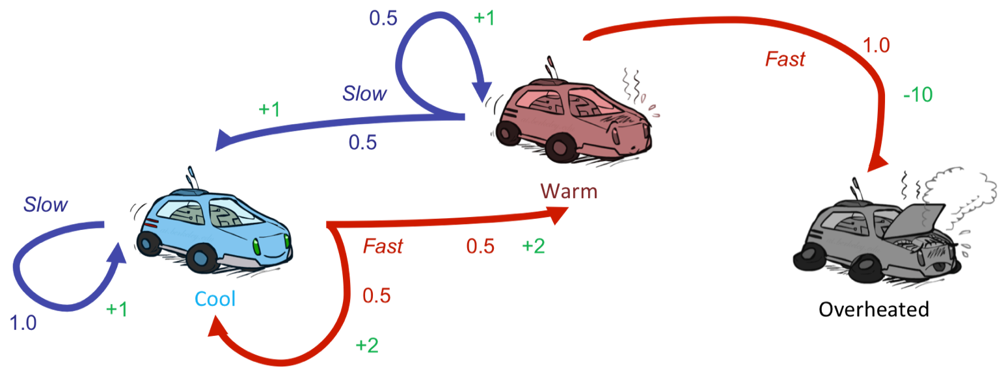
Dynamic Programming
Scenario
In a modified Race car, there is a training track where agent is given a known map and risk factors(dynamics) in advance. Agent knows exactly where it is and its action how actions result in engine state change (KNOWN MODEL).
With full knowledge, the agent can compute optimal policies by trying through all states.
(1)
Deep Reinforcement Learning

Slide 4

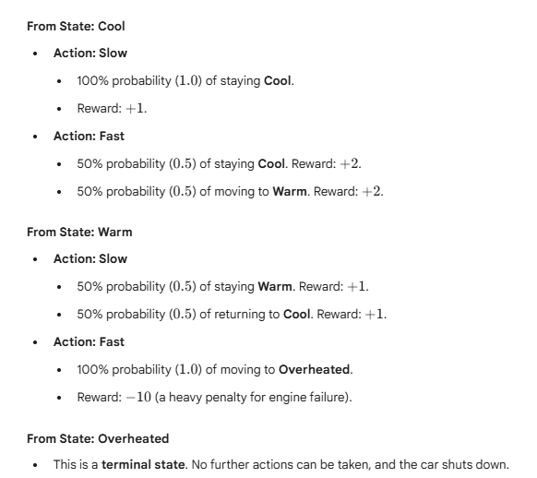



Table of Contents
MDP
DP
MC
TD
1
2
3
4
Deep Reinforcement Learning

Slide 5
Problem Definition
Race Car Laps
A race car completes laps while managing engine temperature and speed decisions. Here each step is a segment of a lap in the track where the car learns to trades off lap time against overheating risk. The more the lap the car completes it performance betters. Car shuts down only when its engine get overheated (optional terminal state).
Key Characteristics:
The agent must act under uncertainty —
percepts are local, and the agent must reason about hidden dangers
Assume there is no fuel constraints or No.of.Laps to complete!
At every time step the next potential engine temperature
depends on the current engine state not the past history
Deep Reinforcement Learning

Slide 6
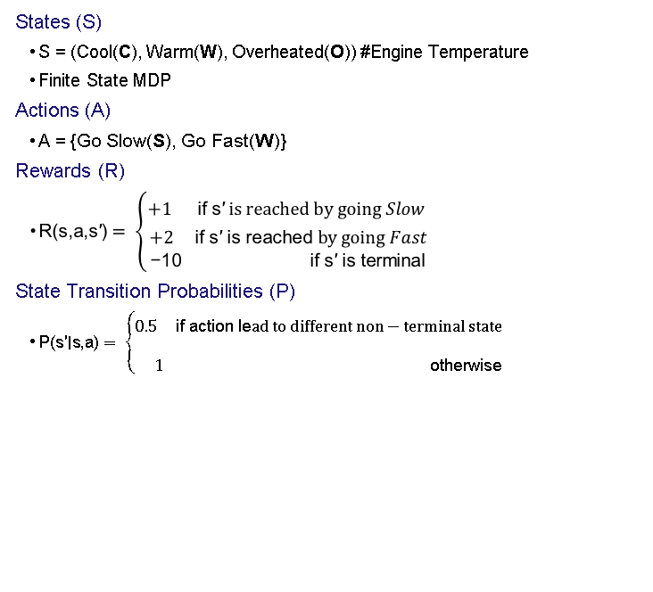
MARKOV DECISION PROCESS FORMALIZATION (Simplified)
1
2
(F) }
3
4
Deep Reinforcement Learning
5
6
7

Slide 7
Dynamic Programming
1
Given
P(s` | s, a) , R(s, a, s`) , P(s`, r | s, a)
2
To find
Policy π
3
Solution
Policy Iteration (PI): Prefer this in a relatively smaller state space where intermediate termination provides explicit interpretable policy
Value Iteration (VI): Prefer this in a relatively larger state space where fast convergence to optimal policy is obtained at the end
VI can be thought of truncated PI where evaluation is done fully before improvement.
4
Idea
PI : One Step Look ahead 🡪 Evaluate 🡪 Improve
VI : One Step Look ahead 🡪 Control
Deep Reinforcement Learning

Slide 8
Dynamic Programming Solution
Value Iteration Algorithm

Slide 9
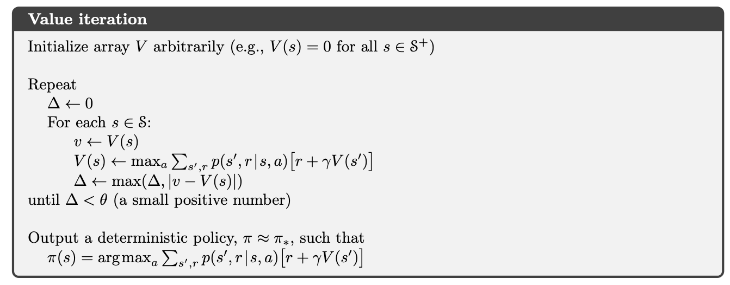

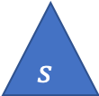

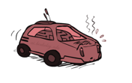
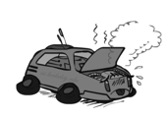
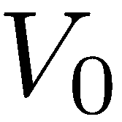


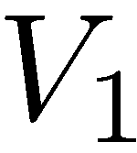



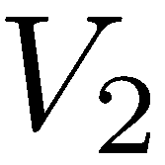
Dynamic Programming – Value Iteration
ɵ = 0.01
Cool
Go Slow Go Fast
0 0 0 ……..
Cool cool warm
(F) }
+1 +2 +2
1.0 0.5 0.5
Synchronous Updates
Deep Reinforcement Learning

Slide 10
Dynamic Programming – Value Iteration
ɵ = 0.01
Cool
Go Slow Go Fast
0 0 0 ……..
Cool cool warm
+1 +2 +2
1.0 0.5 0.5
Synchronous Updates
Deep Reinforcement Learning

Slide 11
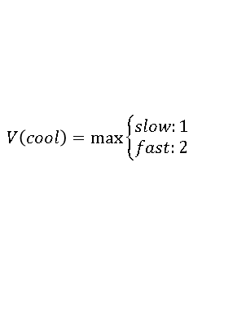
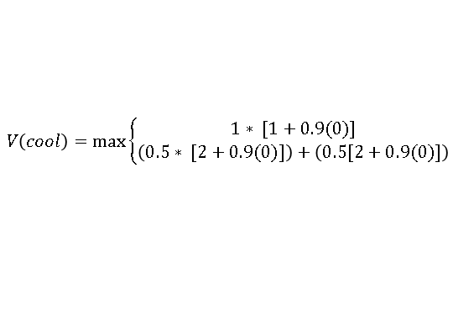
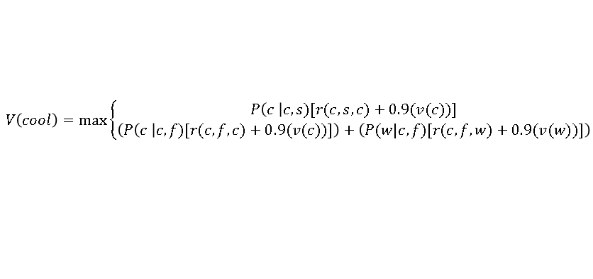
Dynamic Programming – Value Iteration
ɵ = 0.01
Cool
Go Slow Go Fast
0 0 0 ……..
2 1 0……….
Cool cool warm
Below is done only for state : “Cool”. Repeat this for all the states “Warm”, “Overheated” per iteration
+1 +2 +2
1.0 0.5 0.5
Synchronous Updates
Deep Reinforcement Learning

Slide 12
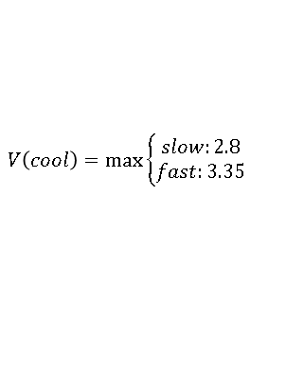
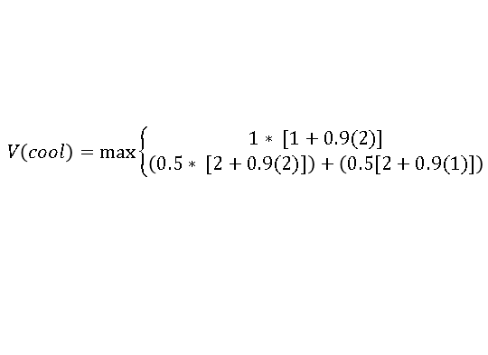
Dynamic Programming – Value Iteration
ɵ = 0.01
Cool
Go Slow Go Fast
0 0 0 ……..
2 1 0……….
Cool cool warm
3.35 2.35 0 ………
Below is done only for state : “Cool”. Repeat this for all the states “Warm”, “Overheated” per iteration
+1 +2 +2
1.0 0.5 0.5
Synchronous Updates
Deep Reinforcement Learning

Slide 13
Dynamic Programming – Value Iteration
ɵ = 0.01
Cool
Go Slow Go Fast
0 0 0 ……..
2 1 0……….
Cool cool warm
3.35 2.35 0 ………
…….
+1 +2 +2
1.0 0.5 0.5
V₄₉
~15.41 ~14.41 0
∆ = ~0.009 less than threshold ɵ = 0.01
Algorithm converges slowly. Without ɵ converges ~208th
Can faster convergence possible ? Yes via Asynchronous Value Updates. Idea is to use the recent values V(S`) even within the same iteration ! One iteration is shown in next slide
Synchronous Updates
Deep Reinforcement Learning

Slide 14
Dynamic Programming – Value Iteration
ɵ = 0.01
Cool
Go Slow Go Fast
0 0 0 ……..
2
Cool cool warm
Below is done only for state : “Cool”. In this same iteration while updating the V(Warm) use recent value of V(Cool) = 2 not 0 .
+1 +2 +2
1.0 0.5 0.5
Asynchronous Updates
Deep Reinforcement Learning

Slide 15
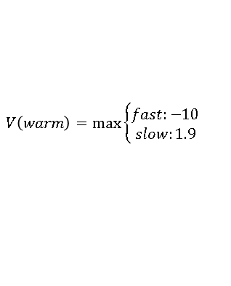
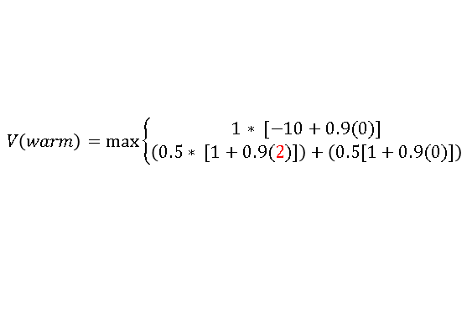
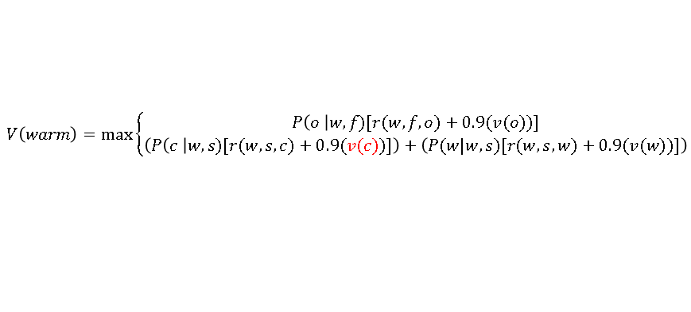
Dynamic Programming – Value Iteration
ɵ = 0.01
Cool
Go Slow Go Fast
0 0 0 ……..
2 1.9 0
Cool cool warm
Below is done only for state : “Cool”. In this same iteration while updating the V(Warm) use recent value of V(Cool) = 2 .
+1 +2 +2
1.0 0.5 0.5
Asynchronous Updates
Deep Reinforcement Learning

Slide 16
Dynamic Programming – Value Iteration
ɵ = 0.01
Cool
Go Slow Go Fast
0 0 0 ……..
2 1.9 0……….
Cool cool warm
3.75 3.54 0 ………
…….
+1 +2 +2
1.0 0.5 0.5
V₄₀
~15.44 ~14.44 0
∆ = ~0.008 less than threshold ɵ = 0.01
Algorithm converges fast. Without ɵ converges at ~157th iteration!
Asynchronous Updates
Deep Reinforcement Learning

Slide 17
Dynamic Programming – Value Iteration
ɵ = 0.01
Cool
Go Slow Go Fast
0 0 0 ……..
2 1.9 0……….
Cool cool warm
3.75 3.54 0 ………
…….
+1 +2 +2
1.0 0.5 0.5
V₄₀
~15.44 ~14.44 0
After convergence extract the policy by choosing the action that lead to the converged maximum value here from V40th iteration
State | Best Action
Cool | Fast
Warm | Slow
Overheated | -
Asynchronous Updates
Deep Reinforcement Learning
Deep Learning

Slide 18

Dynamic Programming Solution
Policy Iteration Algorithm
In many cases, sometimes policies is observed to converge faster than value!
So why wait for entire value updates?

Slide 19
Dynamic Programming
1
Given
P(s` | s, a) , R(s, a, s`) , P(s`, r | s, a)
2
To find
Policy π
3
Solution
Policy Iteration (PI): Prefer this in a relatively smaller state space where intermediate termination provides explicit interpretable policy
Value Iteration (VI): Prefer this in a relatively larger state space where fast convergence to optimal policy is obtained at the end
VI can be thought of truncated PI where evaluation is done fully before improvement.
4
Idea
PI : One Step Look ahead 🡪 Evaluate 🡪 Improve
VI : One Step Look ahead 🡪 Control
🡨 Number of state sweeps (updates) can be controlled if required (similar to mini-batch /stochastic processing). Evaluate & Improve steps are alternatively are done .
Deep Reinforcement Learning

Slide 20
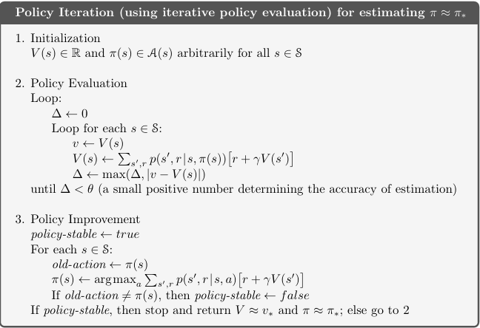
Dynamic Programming – Policy Iteration
ɵ = 0.01
Cool
Go Slow Go Fast
0 0 0 ……..
Cool cool warm
+1 +2 +2
1.0 0.5 0.5
We will use asynchronous for updates in this example. Note that even though above backup diagram depicts all possible transition, this algorithm computes value from only one of the action as given by the initialized policy at the start of every iteration!!!
π₀
State | Best Action
Cool | Slow
Warm | Slow
Overheated | -
Deep Reinforcement Learning

Slide 21
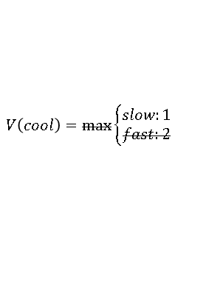
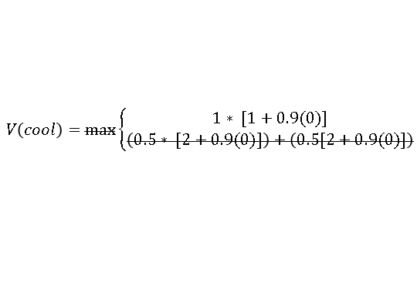
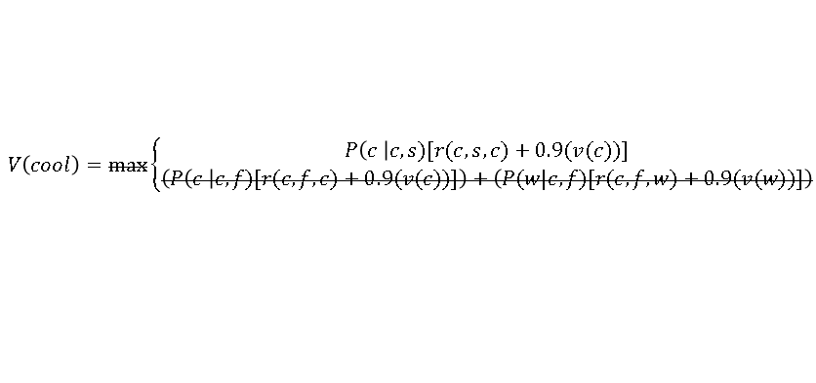
Dynamic Programming – Policy Iteration
Policy Evaluation Starts
ɵ = 0.01
Cool
Go Slow Go Fast
0 0 0 ……..
1 1.45 0……….
Cool cool warm
This slide show what change from Value iteration to Policy iteration algorithm in the Evaluation step!. Since only action needs to be assessed, MAX of all actions outcome is no longer required in this PE cycle!
The value uses the initialized policy to select only one action GREEDILY. Hence below cancelled equations differentiated PI vs VI
+1 +2 +2
1.0 0.5 0.5
Deep Reinforcement Learning

Slide 22
Dynamic Programming – Policy Iteration
Policy Evaluation Completes
ɵ = 0.01
Cool
Go Slow Go Fast
0 0 0 ……..
1 1.45 0……….
Cool cool warm
1.9 2.51 0……….
+1 +2 +2
V₂₂₅
~10 ~ 10 0
1.0 0.5 0.5
In PE, either synchronous or asynchronous value updates can be followed
If Threshold of 0.01 is applied then approx., at 46th iteration algorithm converges
Assume that Asynchronous method is used & Thresholding is not applied. In this case at approx., near 225th iteration values converge
Deep Reinforcement Learning

Slide 23
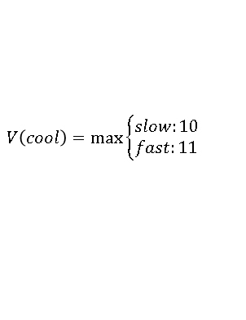
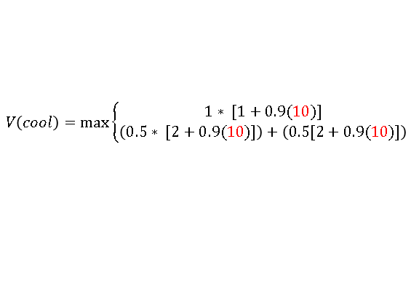
Dynamic Programming – Policy Iteration
Policy Improvement
ɵ = 0.01
Cool
Go Slow Go Fast
0 0 0 ……..
1 1.45 0……….
Cool cool warm
1.9 2.51 0……….
After PE is done, PI starts where the last value from PE is used to find the next best action. In this PI phase all actions are analysed and best action that MAXimises the value is chosen to update the policy
~10 ~ 10 0
+1 +2 +2
V₂₂₅
1.0 0.5 0.5
Deep Reinforcement Learning

Slide 24
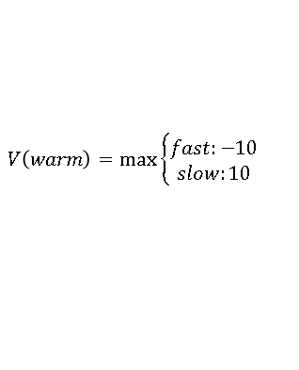
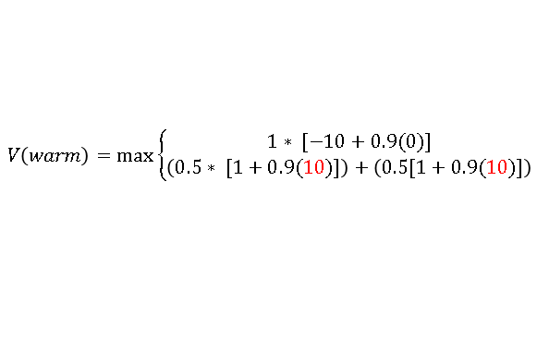
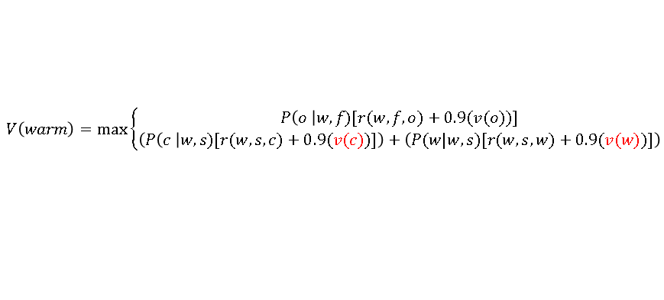
Dynamic Programming – Policy Iteration
Policy Improvement
ɵ = 0.01
Cool
Go Slow Go Fast
0 0 0 ……..
1 1.45 0……….
Cool cool warm
1.9 2.51 0……….
After PE is done, PI starts where the last value from PE is used to find the next best action. In this PI phase all actions are analysed and best action that MAXimises the value is chosen to update the policy
~10 ~ 10 0
+1 +2 +2
V₂₂₅
1.0 0.5 0.5
Deep Reinforcement Learning

Slide 25
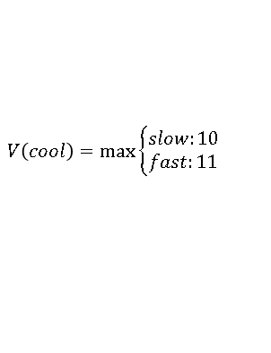
Dynamic Programming – Policy Iteration
Policy Improvement Completes
ɵ = 0.01
Cool
Go Slow Go Fast
0 0 0 ……..
1 1.45 0……….
Cool cool warm
1.9 2.51 0……….
~10 ~ 10 0
+1 +2 +2
V₂₂₅
1.0 0.5 0.5
π₁
State | Best Action
Cool | Fast
Warm | Slow
Overheated | -
Deep Reinforcement Learning

Slide 26
Dynamic Programming – Policy Iteration
Continue another cycle of PE🡪PI
ɵ = 0.01
Cool
Go Slow Go Fast
10 10 0 ……..
Cool cool warm
+1 +2 +2
1.0 0.5 0.5
π₁
State | Best Action
Cool | Fast
Warm | Slow
Overheated | -
After this cycle of algorithm converges with values :
V(cool) = 15.5
V(Warm) = 14.5
Deep Reinforcement Learning

Slide 27
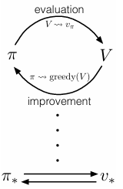
Dynamic Programming - Policy Iteration
1
Observation
Policy iteration consists of two simultaneous, interacting processes, one making the value function consistent with the current policy (policy evaluation), and the other making the policy greedy with respect to the current value function (policy improvement).
In policy iteration, these two processes alternate, each completing before the other begins, but this is not really necessary.
Generalized policy iteration (GPI) to refer to the general idea of letting policy-evaluation and policy improvement processes interact, independent of the granularity and other details of the two processes. Almost all reinforcement learning methods are well described as GPI.
In one cycle perform only one iteration of Policy Evaluation (ie.,Value Updates) without waiting for convergence immediately follow by Policy Improvement.
Solution : GPI Generalized Policy Iteration
Idea (Do this as an exercise for given problem)
Deep Reinforcement Learning

Slide 28


Table of Contents
MDP
DP
MC
TD
1
2
3
4
Deep Reinforcement Learning

Slide 29
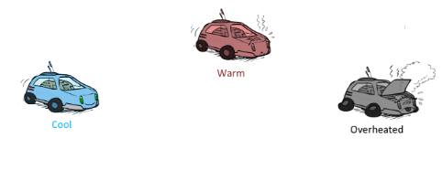
Problem Definition
Race Car Laps
In a modified Race car, there is a training track where agent is given a known (sometimes incomplete) map and risk factors(dynamics) may not be known in advance. Agent knows exactly where it is but its actions impact on the engine state change is difficult to predict (UNKNOWN MODEL).
With partial knowledge, the agent can compute optimal policies by trying through random experiments (Sampling). Car shuts down when its engine get overheated (optional terminal state) or Car stops once the predefined no.of.laps are completed.
Key Characteristics:
The agent must act under uncertainty —
percepts are local, and the agent must reason about hidden dangers
Assume there are fuel constraints or/and No.of.Laps to complete!
At every time step there is no way clear indication of
Impact of next potential engine temperature depending on the
current engine state. The entire past changes might lead to any
possible state change. Hence immediate reward is not always available.
Deep Reinforcement Learning

Slide 30
MARKOV DECISION PROCESS FORMALIZATION (Reduced)
States (S)
S = (Cool(C), Warm(W), Overheated(O)) #Engine Temperature
Finite State MDP
Actions (A)
A = {Go Slow(S), Go Fast(F)}
Rewards (R) and/or State Transition Probabilities (P)
may be non-stationary
Policy still needs estimation of V(S) , Q(S,A) i.e., MDP components but its is not a necessity that the process is expected to follow a Markov Property!! ☺
1
2
3
4
Deep Reinforcement Learning
5
6
7

Slide 31
Monte Carlo Methods
1
Given
S, A, optionally R(s, a, s`)
2
To find
Policy π
3
Solution
Sample Episodes
Compute estimates of the value by discounted returns
Simple average
Weighted average
Normalized weighted average
4
Idea
On Policy :
Generate Sample/Experience 🡪 Evaluate using Return 🡪 Improve
Off Policy :
Refer to Sample/Experience generated by another reference(behavior) policy 🡪 Evaluate using Return 🡪 Improve
Deep Reinforcement Learning

Slide 32
Monte Carlo Method
On Policy Control Algorithm

Slide 33
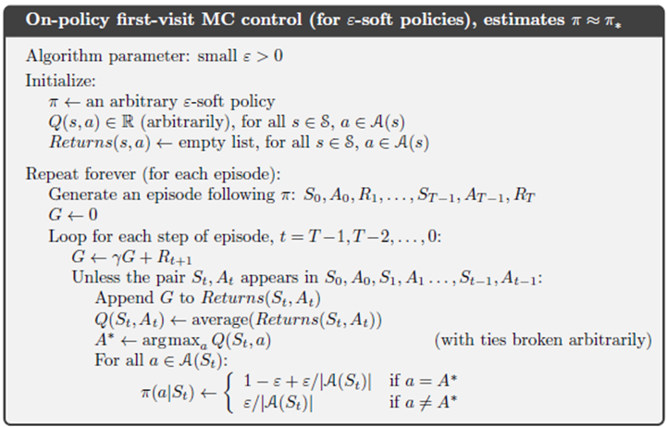


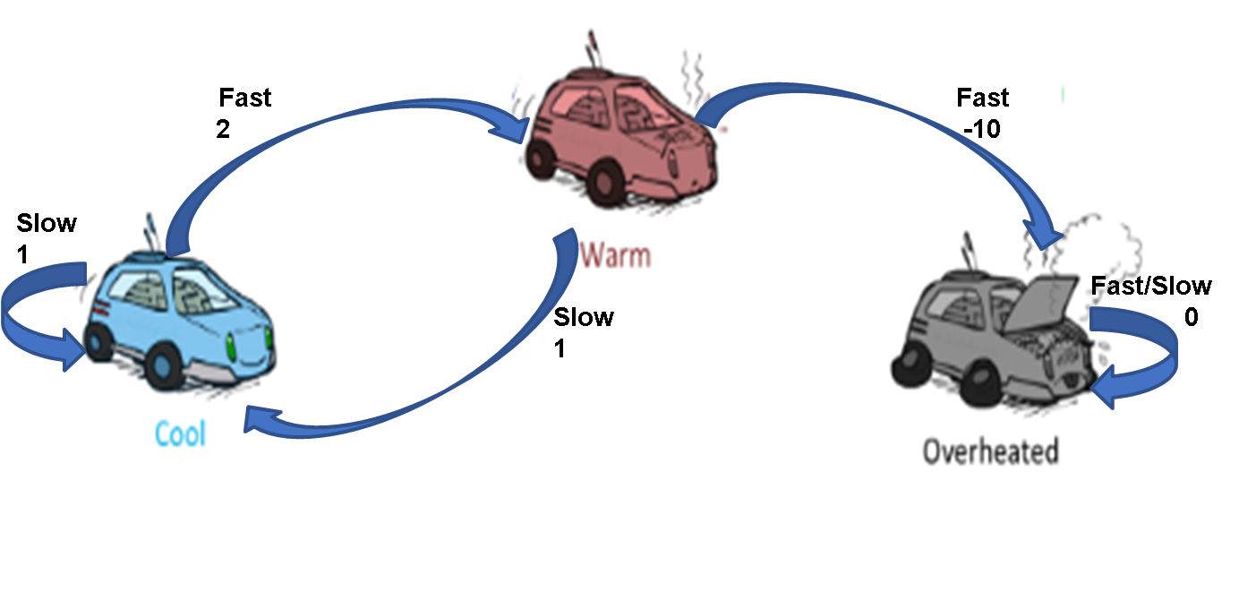
Monte Carlo
Ꜫ = 0.2
γ = 0.6
Q₀
Q₁
Q₂
0 0 0 0 0 0
π₀
State | Best Action | P(F) | P(S)
Cool | Slow | 0.4 | 0.6
Warm | Fast | 0.6 | 0.4
Overheated | - | - | -
First Visit Policy Evaluation
Deep Reinforcement Learning

Slide 34
Monte Carlo
Ꜫ = 0.2
γ = 0.6
Q₀
Q₁
Q₂
0 0 0 0 0 0
π₀
State | Best Action | P(F) | P(S)
Cool | Slow | 0.4 | 0.6
Warm | Fast | 0.6 | 0.4
Overheated | - | - | -
Episode 1: C, F, 2, W, S, 1, C, F, 2, W, F, -10, O
G=0
First Visit Policy Evaluation
Deep Reinforcement Learning

Slide 35
Monte Carlo
Ꜫ = 0.2
γ = 0.6
Q₀
Q₁
Q₂
0 0 0 0 0 0
-4 ,1.16 0 -10 -1.4 0 0
π₀
State | Best Action | P(F) | P(S)
Cool | Slow | 0.4 | 0.6
Warm | Fast | 0.6 | 0.4
Overheated | - | - | -
Episode 1: C, F, 2, W, S, 1, C, F, 2, W, F, -10, O
G=0
t=3: G₃ = -10
t=2: G₂ = 2 + (0.6)(-10) = -4 #Not used in First Visit
t=1: G₁ = 1+ (0.6*2) + (0.6*0.6*-10) = -1.4
t=0: G₀ = 2+ (0.6*1) + (0.6*0.6*2) + (0.6*0.6*0.6-10) = 1.16
First Visit Policy Evaluation
Deep Reinforcement Learning

Slide 36
Monte Carlo
Ꜫ = 0.2
γ = 0.6
Q₀
Q₁
Q₂
0 0 0 0 0 0
-4 ,1.16 0 -10 -1.4 0 0
π₀
State | Best Action | P(F) | P(S)
Cool | Slow | 0.4 | 0.6
Warm | Fast | 0.6 | 0.4
Overheated | - | - | -
Episode 1: C, F, 2, W, S, 1, C, F, 2, W, F, -10, O
G=0
t=3: G₃ = -10
t=2: G₂ = 2 + (0.6)(-10) = -4 #Not used in First Visit
t=1: G₁ = 1+ (0.6*2) + (0.6*0.6*-10) = -1.4
t=0: G₀ = 2+ (0.6*1) + (0.6*0.6*2) + (0.6*0.6*0.6-10) = 1.16
Episode 1:
t=3: Q(W, F) = -10
t=2: Q(C, F) = -4
t=1: Q(W, S) = -1.4
t=0: Q(C, F) = 1.16
First Visit Policy Evaluation
Deep Reinforcement Learning

Slide 37
Monte Carlo
Ꜫ = 0.2
γ = 0.6
Q₀
Q₁
Q₂
0 0 0 0 0 0
1.16 0 -10 -1.4 0 0
π₁
State | Best Action | P(F) | P(S)
Cool | Slow | 0.2 | 0.8
Warm | Slow | 0.2 | 0.8
Overheated | - | - | -
Episode 1: C, F, 2, W, S, 1, C, F, 2, W, F, -10, O
G=0
t=3: G₃ = -10
t=2: G₂ = 2 + (0.6)(-10) = -4 #Not used in First Visit
t=1: G₁ = 1+ (0.6*2) + (0.6*0.6*-10) = -1.4
t=0: G₀ = 2+ (0.6*1) + (0.6*0.6*2) + (0.6*0.6*0.6-10) = 1.16
Episode 1:
t=3: Q(W, F) = -10
t=2: Q(C, F) = -4
t=1: Q(W, S) = -1.4
t=0: Q(C, F) = 1.16
Policy Improvement
Deep Reinforcement Learning

Slide 38
Monte Carlo
Ꜫ = 0.2
γ = 0.6
Q₀
Q₁
Q₂
0 0 0 0 0 0
1.16 0 -10 -1.4 0 0
π₁
State | Best Action | P(F) | P(S)
Cool | Slow | 0.2 | 0.8
Warm | Slow | 0.2 | 0.8
Overheated | - | - | -
Episode 1: C, F, 2, W, S, 1, C, F, 2, W, F, -10, O
G=0
t=3: G₃ = -10
t=2: G₂ = 2 + (0.6)(-10) = -4 #Not used in First Visit
t=1: G₁ = 1+ (0.6*2) + (0.6*0.6*-10) = -1.4
t=0: G₀ = 2+ (0.6*1) + (0.6*0.6*2) + (0.6*0.6*0.6-10) = 1.16
Episode 2: C, S, 1, C, F, 2, W, F, -10, O
G=0
t=2: G₂ = -10
t=1: G₁ = 2 + (0.6)(-10) = -4
t=0: G₀ = 1+ (0.6*2) + (0.6*0.6*-10) = -1.4
Episode 1:
t=3: Q(W, F) = -10
t=2: Q(C, F) = -4
t=1: Q(W, S) = -1.4
t=0: Q(C, F) = 1.16
Policy Evaluation
Deep Reinforcement Learning

Slide 39
Monte Carlo
Ꜫ = 0.2
γ = 0.6
Q₀
Q₁
Q₂
0 0 0 0 0 0
1.16 0 -10 -1.4 0 0
π₁
State | Best Action | P(F) | P(S)
Cool | Slow | 0.2 | 0.8
Warm | Slow | 0.2 | 0.8
Overheated | - | - | -
-1.42 -1.4 -10 0 0 0
Episode 1: C, F, 2, W, S, 1, C, F, 2, W, F, -10, O
G=0
t=3: G₃ = -10
t=2: G₂ = 2 + (0.6)(-10) = -4 #Not used in First Visit
t=1: G₁ = 1+ (0.6*2) + (0.6*0.6*-10) = -1.4
t=0: G₀ = 2+ (0.6*1) + (0.6*0.6*2) + (0.6*0.6*0.6-10) = 1.16
Episode 2: C, S, 1, C, F, 2, W, F, -10, O
G=0
t=2: G₂ = -10
t=1: G₁ = 2 + (0.6)(-10) = -4
t=0: G₀ = 1+ (0.6*2) + (0.6*0.6*-10) = -1.4
Episode 1:
t=3: Q(W, F) = -10
t=2: Q(C, F) = -4
t=1: Q(W, S) = -1.4
t=0: Q(C, F) = 1.16
Episode 2:
t=2: Q(W, F) = -10
t=1: Q(C, F) = avg(1.16,-4) = -1.42
t=0: Q(C, S) = -1.4
Policy PE & PI
Deep Reinforcement Learning

Slide 40
Monte Carlo
Ꜫ = 0.2
γ = 0.6
Q₀
Q₁
Q₂
0 0 0 0 0 0
1.16 0 -10 -1.4 0 0
π₁
State | Best Action | P(F) | P(S)
Cool | Slow | 0.2 | 0.8
Warm | Slow | 0.2 | 0.8
Overheated | - | - | -
-1.42 -1.4 -10 0 0 0
Episode 3: C, S, 1, C, S, 1, C, F, 2, W, F, -10, O
G=0
t=3: G₃ = -10
t=2: G₂ = 2 + (0.6)(-10) = -4
t=1: G₁ = 1+ (0.6*2) + (0.6*0.6*-10) = -1.4
t=0: G₀ = 1+ (0.6*1) + (0.6*0.6*2) + (0.6*0.6*0.6-10) = 0.16
Episode 3:
t=3: Q(W, F) = -10
t=2: Q(C, F) = avg(-4,1.16,-4) = -2.28
t=1: Q(C, S) = -1.4
t=0: Q(C, S) = avg(0.16,-1.4)
= -0.62
First Visit Policy Evaluation
Deep Reinforcement Learning

Slide 41
Monte Carlo
Ꜫ = 0.2
γ = 0.6
Q₀
Q₁
Q₂
Q₃
0 0 0 0 0 0
1.16 0 -10 -1.4 0 0
π₂
State | Best Action | P(F) | P(S)
Cool | Slow | 0.2 | 0.8
Warm | Slow | 0.2 | 0.8
Overheated | - | - | -
-1.42 -1.4 -10 0 0 0
-2.28 -0.62 -10 0 0 0
Episode 3:
t=3: Q(W, F) = -10
t=2: Q(C, F) = avg(-4,1.16,-4) = -2.28
t=1: Q(C, S) = -1.4
t=0: Q(C, S) = avg(0.16,-1.4)
= -0.62
After PE PI no change in π.
Policy converges towards safer actions
Deep Reinforcement Learning

Slide 42
Monte Carlo Methods
1
Given
S, A, optionally R(s, a, s`)
2
To find
Policy π . This is referred to as TARGET policy
3
Solution
Sample Episodes
Compute estimates of the value by discounted returns
Simple average
Weighted average
Normalized weighted average
4
Idea
On Policy :
Generate Sample/Experience 🡪 Evaluate using Return 🡪 Improve
Off Policy :
Refer to Sample/Experience generated by another reference(BEHAVIOUR) policy 🡪 Evaluate using Return 🡪 Improve
Deep Reinforcement Learning

Slide 43
Monte Carlo Method
Off Policy Control Algorithm

Slide 44
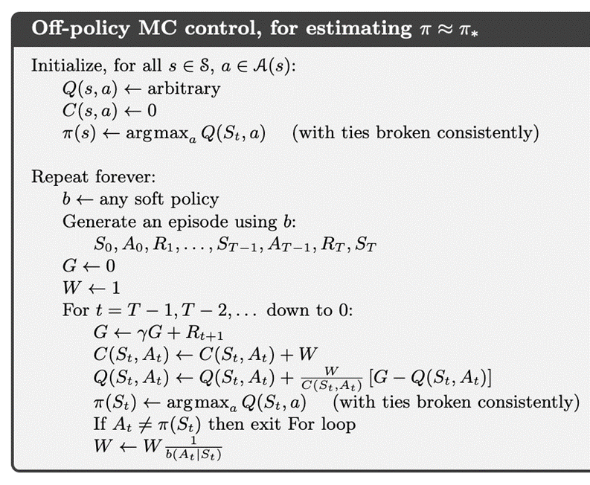
Monte Carlo
Ꜫ = 0.2
γ = 0.6
Q
π
C
0 0 0 0 0 0
b
State | P(F) | P(S)
Cool | 0.4 | 0.6
Warm | 0.6 | 0.4
Overheated | - | -
Assume deterministic Target policy. Hence π(A_{t} | S_{t}) = 1
But the behavior policy (b) is Stochastic as defined
Deep Reinforcement Learning

Slide 45
Monte Carlo
Ꜫ = 0.2
γ = 0.6
Ep
G
W
t
A_{t}
π(S_{t})
Q
π
C
0 0 0 0 0 0
✔
✔
b
State | P(F) | P(S)
Cool | 0.4 | 0.6
Warm | 0.6 | 0.4
Overheated | - | -
0 0 0 0 0 0
Every Visit Policy Evaluation
Deep Reinforcement Learning

Slide 46
Monte Carlo
Ꜫ = 0.2
γ = 0.6
Ep | 1
G | 0
W | 1
t
A_{t}
π(S_{t})
Q
π
C
0 0 0 0 0 0
✔
✔
b
State | P(F) | P(S)
Cool | 0.4 | 0.6
Warm | 0.6 | 0.4
Overheated | - | -
0 0 0 0 0 0
Episode 1: C, F, 2, W, S, 1, C, F, 2, W, F, -10, O
G=0
First Visit Policy Evaluation
Deep Reinforcement Learning

Slide 47
Monte Carlo
Ꜫ = 0.2
γ = 0.6
Ep | 1
G | 0
W | 1
t | 3
A_{t} | F
π(S_{t}) | F
Q
π
C
0 0 0 0 0 0
✔
✔
b
State | P(F) | P(S)
Cool | 0.4 | 0.6
Warm | 0.6 | 0.4
Overheated | - | -
0 0 0 0 0 0
Episode 1: C, F, 2, W, S, 1, C, F, 2, W, F, -10, O
G=0
t=3: G₃ = -10
First Visit Policy Evaluation
Deep Reinforcement Learning

Slide 48
Monte Carlo
Ꜫ = 0.2
γ = 0.6
Ep | 1
G | -10
W | 1
t | 3
A_{t} | F
π(S_{t}) | F
Q
π
C
0 0 0 0 0 0
✔
✔
b
State | P(F) | P(S)
Cool | 0.4 | 0.6
Warm | 0.6 | 0.4
Overheated | - | -
0 0 1 0 0 0
Episode 1: C, F, 2, W, S, 1, C, F, 2, W, F, -10, O
G=0
t=3: G₃ = -10
Compute Return & Update the Count for Averaging
Deep Reinforcement Learning

Slide 49
Monte Carlo
Ꜫ = 0.2
γ = 0.6
Ep | 1
G | -10
W | 1
t | 3
A_{t} | F
π(S_{t}) | F
Q
π
C
0 0 -10 0 0 0
✔
✔
b
State | P(F) | P(S)
Cool | 0.4 | 0.6
Warm | 0.6 | 0.4
Overheated | - | -
0 0 1 0 0 0
Episode 1: C, F, 2, W, S, 1, C, F, 2, W, F, -10, O
G=0
t=3: G₃ = -10
Compute the action value Q(W,F) using incremental update form adapted to perform normalized weighted average based updates. This is the WEIGHTED IMPORTANCE SAMPLING METHOD, which bounds the variance due to the normalizing effect!
Deep Reinforcement Learning

Slide 50
Monte Carlo
Ꜫ = 0.2
γ = 0.6
Ep | 1
G | -10
W | 1
t | 3
A_{t} | F
π(S_{t}) | S
Q
π
C
0 0 -10 0 0 0
Policy Improvement
✔
✔
b
State | P(F) | P(S)
Cool | 0.4 | 0.6
Warm | 0.6 | 0.4
Overheated | - | -
0 0 1 0 0 0
Episode 1: C, F, 2, W, S, 1, C, F, 2, W, F, -10, O
G=0
t=3: G₃ = -10
The best action is not the currently encountered action in the sample!
Deep Reinforcement Learning

Slide 51
Monte Carlo
Ꜫ = 0.2
γ = 0.6
Ep | 1
G | -10
W | 1
t | 3
A_{t} | F
π(S_{t}) | S
Q
π
C
0 0 -10 0 0 0
✔
✔
b
State | P(F) | P(S)
Cool | 0.4 | 0.6
Warm | 0.6 | 0.4
Overheated | - | -
0 0 1 0 0 0
Episode 1: C, F, 2, W, S, 1, C, F, 2, W, F, -10, O
G=0
t=3: G₃ = -10
Exits to the next time step without W update!
Deep Reinforcement Learning

Slide 52
Monte Carlo
Ꜫ = 0.2
γ = 0.6
Ep | 1
G | -10
W | 1
t | 2
A_{t} | F
π(S_{t}) | S
Q
π
C
0 0 -10 0 0 0
✔
✔
b
State | P(F) | P(S)
Cool | 0.4 | 0.6
Warm | 0.6 | 0.4
Overheated | - | -
0 0 1 0 0 0
Episode 1: C, F, 2, W, S, 1, C, F, 2, W, F, -10, O
G=0
t=3: G₃ = -10
t=2: G₂ = 2 + (0.6)(-10) = -4 #WILL BE used in EVERY Visit
Continue ……..
Deep Reinforcement Learning

Slide 53
Monte Carlo
Ꜫ = 0.2
γ = 0.6
Ep | 1
G | -4
W | 1
t | 2
A_{t} | F
π(S_{t}) | S
Q
π
C
-4 0 -10 0 0 0
✔
✔
b
State | P(F) | P(S)
Cool | 0.4 | 0.6
Warm | 0.6 | 0.4
Overheated | - | -
1 0 1 0 0 0
Episode 1: C, F, 2, W, S, 1, C, F, 2, W, F, -10, O
G=0
t=3: G₃ = -10
t=2: G₂ = 2 + (0.6)(-10) = -4
No change in W! Exit to next t
Deep Reinforcement Learning

Slide 54
Monte Carlo
Ꜫ = 0.2
γ = 0.6
Ep | 1
G | -1.4
W | 1
t | 1
A_{t} | S
π(S_{t}) | S
Q
π
C
-4 0 -10 -1.4 0 0
✔
✔
b
State | P(F) | P(S)
Cool | 0.4 | 0.6
Warm | 0.6 | 0.4
Overheated | - | -
1 0 1 1 0 0
Episode 1: C, F, 2, W, S, 1, C, F, 2, W, F, -10, O
G=0
t=3: G₃ = -10
t=2: G₂ = 2 + (0.6)(-10) = -4
t=1: G₁ = 1+ (0.6*2) + (0.6*0.6*-10) = -1.4
Continue ……..
Deep Reinforcement Learning

Slide 55
Monte Carlo
Ꜫ = 0.2
γ = 0.6
Ep | 1
G | -1.4
W | 2.5
t | 1
A_{t} | S
π(S_{t}) | S
Q
π
C
-4 0 -10 -1.4 0 0
W = 1/b(S|W)
= 1/0.4
=2.5
✔
✔
b
State | P(F) | P(S)
Cool | 0.4 | 0.6
Warm | 0.6 | 0.4
Overheated | - | -
1 0 1 1 0 0
Episode 1: C, F, 2, W, S, 1, C, F, 2, W, F, -10, O
G=0
t=3: G₃ = -10
t=2: G₂ = 2 + (0.6)(-10) = -4
t=1: G₁ = 1+ (0.6*2) + (0.6*0.6*-10) = -1.4
At t=1 the best action & current action is same .Hence the Global Weight for WIS is updated
Deep Reinforcement Learning

Slide 56

Monte Carlo
Ꜫ = 0.2
γ = 0.6
Ep | 1
G | -1.4
W | 2.5
t | 0
A_{t} | F
π(S_{t}) | S
Q
π
C
-3.14 0 -10 -1.4 0 0
✔
✔
b
State | P(F) | P(S)
Cool | 0.4 | 0.6
Warm | 0.6 | 0.4
Overheated | - | -
3.5 0 1 1 0 0
Episode 1: C, F, 2, W, S, 1, C, F, 2, W, F, -10, O
G=0
t=3: G₃ = -10
t=2: G₂ = 2 + (0.6)(-10) = -4
t=1: G₁ = 1+ (0.6*2) + (0.6*0.6*-10) = -1.4
t=0: G₀ = 2+ (0.6*1) + (0.6*0.6*2) + (0.6*0.6*0.6-10) = 1.16
Continuing to next t=0……..
After update observe that the episode terminates
Deep Reinforcement Learning

Slide 57

Monte Carlo
Ꜫ = 0.2
γ = 0.6
Ep | 2
G | 0 🡪-10
W | 1
t | 2
A_{t} | F
π(S_{t}) | S
Q
π
C
-3.14 0 -10 -1.4 0 0
✔
✔
b
State | P(F) | P(S)
Cool | 0.4 | 0.6
Warm | 0.6 | 0.4
Overheated | - | -
3.5 0 2 1 0 0
Episode 1: C, F, 2, W, S, 1, C, F, 2, W, F, -10, O
Episode 2: C, S, 1, C, F, 2, W, F, -10, O
G=0
t=2: G₂ = -10
Generate new episode from “b” . Continue ……
Results of every time-step in Episode 2 is shown
Deep Reinforcement Learning

Slide 58

Monte Carlo
Ꜫ = 0.2
γ = 0.6
Ep | 2
G | -10🡪-4
W | 1
t | 1
A_{t} | F
π(S_{t}) | S
Q
π
C
-7.01 0 -10 -1.4 0 0
✔
✔
b
State | P(F) | P(S)
Cool | 0.4 | 0.6
Warm | 0.6 | 0.4
Overheated | - | -
4.5 0 2 1 0 0
Episode 1: C, F, 2, W, S, 1, C, F, 2, W, F, -10, O
Episode 2: C, S, 1, C, F, 2, W, F, -10, O
G=0
t=2: G₂ = -10
t=1: G₁ = 2 + (0.6)(-10) = -4
Continue ……
Results of every time-step in Episode 2 is shown
Deep Reinforcement Learning

Slide 59

Monte Carlo
Ꜫ = 0.2
γ = 0.6
Ep | 2
G | -4🡪-1.4
W | 1.67
t | 0
A_{t} | S
π(S_{t}) | S
Q
π
C
-7.01 -1.4 -10 -1.4 0 0
W = 1/b(S|W)
= 1/0.6
=~1.67
✔
✔
b
State | P(F) | P(S)
Cool | 0.4 | 0.6
Warm | 0.6 | 0.4
Overheated | - | -
4.5 1 2 1 0 0
Episode 1: C, F, 2, W, S, 1, C, F, 2, W, F, -10, O
Episode 2: C, S, 1, C, F, 2, W, F, -10, O
G=0
t=2: G₂ = -10
t=1: G₁ = 2 + (0.6)(-10) = -4
t=0: G₀ = 1+ (0.6*2) + (0.6*0.6*-10) = -1.4
This completes processing second episode. Continue next episode
Deep Reinforcement Learning

Slide 60
Monte Carlo Methods
1
Given
S, A, optionally R(s, a, s`)
2
To find
Policy π . This is referred to as TARGET policy
3
Solution
Sample Episodes
Compute estimates of the value by discounted returns
Simple average
Weighted average (OIS : Ordinary Importance Sampling)
Normalized weighted average (WIS : Weighted Importance Sampling)
4
Idea
On Policy :
Generate Sample/Experience 🡪 Evaluate using Return 🡪 Improve
Off Policy :
Refer to Sample/Experience generated by another reference(BEHAVIOUR) policy 🡪 Evaluate using Return 🡪 Improve
Deep Reinforcement Learning

Slide 61
Monte Carlo
Ꜫ = 0.2
γ = 0.6
Ep
G
W
t
A_{t}
π(S_{t})
Q
π
C
-7.01 -1.4 -10 -1.4 0 0
✔
✔
b
State | P(F) | P(S)
Cool | 0.4 | 0.6
Warm | 0.6 | 0.4
Overheated | - | -
4.5 1 2 1 0 0
Episode 1: C, F, 2, W, S, 1, C, F, 2, W, F, -10, O
Episode 2: C, S, 1, C, F, 2, W, F, -10, O
Important Note : The Ordinary Importance Sampling (OIS) is unbiased but will produce high variance. The same given algorithm can be adapted to perform ordinary importance sampling by changing only the count update equation to : C(St,At) 🡨 C(St,At) + 1
Deep Reinforcement Learning

Slide 62
Monte Carlo
Ꜫ = 0.2
γ = 0.6
Ep | 3
G | 0
W | 1
t
A_{t}
π(S_{t})
Q
π
C
-7.01 -1.4 -10 -1.4 0 0
✔
✔
b
State | P(F) | P(S)
Cool | 0.4 | 0.6
Warm | 0.6 | 0.4
Overheated | - | -
4.5 1 2 1 0 0
Episode 1: C, F, 2, W, S, 1, C, F, 2, W, F, -10, O
Episode 2: C, S, 1, C, F, 2, W, F, -10, O
Episode 3: C, S, 1, C, S, 1, C, F, 2, W, F, -10, O
Students are advised to take this episode #3 as an exercise for practice …………
Deep Reinforcement Learning

Slide 63
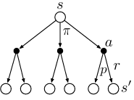


DP VS MC
s
a
s`
a`
.
.
S_{T}
Deep Reinforcement Learning

Slide 64
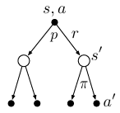



DP VS MC
s,a
s`
a`
.
.
S_{T}
Deep Reinforcement Learning

Slide 65
Table of Contents
MDP
DP
MC
TD
1
2
3
4
Deep Reinforcement Learning

Slide 66
Problem Definition
(Modified) Race Car Example
In a modified Race car, there is a training track where agent is given a known (sometimes incomplete) map and risk factors(dynamics) may not be known in advance. Agent knows exactly where it is but its actions impact on the engine state change is difficult to predict (UNKNOWN MODEL).
With partial knowledge, the agent can compute optimal policies by trying through random experiments (Sampling). Car sometimes may shuts down when its engine get overheated (optional terminal state) otherwise Race is allowed to proceed indefinitely (NO predefined no.of.laps to complete)
Key Characteristics:
The agent must act under uncertainty —
percepts are local, and the agent must reason about hidden dangers
Assume there are neither fuel constraints nor No.of.Laps to complete!
At every time step there is an indication (direct/indirect) of
Impact of next potential engine temperature depending on the
current engine state. Immediate reward is available.
Deep Reinforcement Learning

Slide 67
Temporal Difference Learning Methods
1
Given
S, A, R(s, a, s`), (optionally)P(a | s)
2
To find
Policy π
3
Solution
Sample Episodes
Compute estimates of the value by discounted next state estimates (bootstrapping)
Simple average
Weighted average
Normalized weighted average
4
Idea
On Policy :
Generate Sample/Experience 🡪 Evaluate using bootstrapping 🡪 Improve
Off Policy :
Refer to Sample/Experience generated by another reference(behavior) policy 🡪 Evaluate using bootstrapping 🡪 Improve
Deep Reinforcement Learning

Slide 68
Temporal Difference Learning Methods
Policy Evaluation (PE) Algorithm
TD(0)

Slide 69
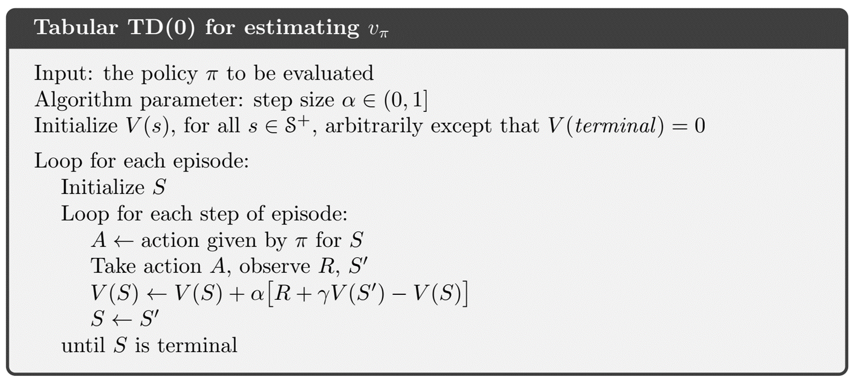
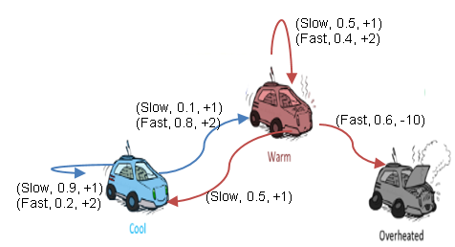
TD(0)
Ꜫ = 0.1
γ = 0.9
α = 0.5
V₀
V₁
V₂
0 0 0
Episode 1: C
Important Note :
In few textbooks/ running incremental upcoming examples, dynamics are given so only to simulate trajectories and show updates step by step. TD itself doesn’t require knowing the full transition model — it only needs sampled transitions (s,a,r,s′) while training from scratch ie., when policy is not known/learnt yet.
The dynamics are provided for clarity and reproducibility, not because TD requires them. In practice, TD works model-free, just like Monte Carlo.
π
Use case : A driving policy is already learnt which needs to be evaluated for monitoring or certification/approval by safety engineers.
Deep Reinforcement Learning

Slide 70
TD(0)
Ꜫ = 0.1
γ = 0.9
α = 0.5
V₀
V₁
V₂
1 0 0
Episode 1: C, F, 2, W
Target = R+ γV(W) = 2+(0.9 * 0) = 2
TD Error = Target – Old Estimate = 2-V(C) = 2-0 = 2
Update the value : V(C) = 0 + 0.5(2) = 1
π
Deep Reinforcement Learning

Slide 71
TD(0)
Ꜫ = 0.1
γ = 0.9
α = 0.5
V₀
V₁
V₂
1 0.95 0
Episode 1: C, F, 2, W, S, 1, C
V(W) = 0 + 0.5 [1+ (0.9*1)-0] = 0.95
π
In practice, we can define an episode cutoff (e.g., after 2 or10 steps or when Overheated occurs). If Overheated isn’t reached, still the episode an be programmed to end artificially. That’s how learning continues.
Deep Reinforcement Learning

Slide 72
TD(0)
Ꜫ = 0.1
γ = 0.9
α = 0.5
V₀
V₁
V₂
1 0.95 0
1.95 2.40 1.40
Episode 1: C, F, 2, W, S, 1, C
Episode 2: C, F, 2, C, F, 2, W, S, 1, W
t=0 : V(C) = 1 + 0.5 [2+ (0.9*1)-1] = 1.95
t=1 : V(C) = 1.95 + 0.5 [2+ (0.9*0.95)-1.95] = ~2.4
t=2 : V(W) = 0.95 + 0.5 [1+ (0.9*0.95)-0.95] = ~1.40
π
Continued for 1 more episode…..
Deep Reinforcement Learning

Slide 73
Temporal Difference Learning Methods
On Policy Control Algorithms

Slide 74
Temporal Difference Learning Methods
On Policy Control Algorithms
SARSA

Slide 75
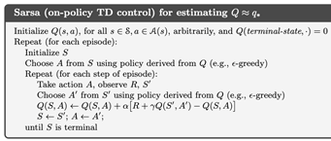
SARSA
Ꜫ = 0.1
γ = 0.9
α = 0.8
Q₀
Q₁
Q₂
0 0 0 0 0 0
Episode 1: C
π
Use case : A driving policy is already learnt but there are few unforeseen changes. Policy needs to be retrained to reflect the actual risk observed via exploration
Deep Reinforcement Learning

Slide 76
SARSA
Ꜫ = 0.1
γ = 0.9
α = 0.8
Q₁
Q₂
Q₃
1.6 0 0 0 0 0
Episode 1: C, F, 2, W, S
Q(C,F) = 0 + 0.8 [2+ (0.9*0)-0] = 1.6
π
From State “C” & “W”, Action “F” & “S” are derived respectively by applying E-greedy on current policy from Q values learnt till now.
In the shown time step : (S,A,R,S,A) = (C,F,2,W,S)
Deep Reinforcement Learning

Slide 77
SARSA
Ꜫ = 0.1
γ = 0.9
α = 0.8
Q₁
Q₂
Q₃
1.6 0 0 1.95 0 0
Episode 1: C, F, 2, W, S, 1, C , F
Q(W,S) = 0 + 0.6 [1+ (0.9*1.6)-0] = ~1.95
π
Terminating episode 1 after 2 steps. In practice, we can define an episode cutoff (e.g., after 2 or10 steps or when Overheated occurs). If Overheated isn’t reached, still the episode an be programmed to end artificially. That’s how learning continues.
Deep Reinforcement Learning

Slide 78
SARSA
Ꜫ = 0.1
γ = 0.9
α = 0.8
Q₁
Q₂
Q₃
1.6 0 0 1.95 0
3.62 0 -8 1.32 0
Episode 1: C, F, 2, W, S, 1, C , F
Episode 2: C, F, 2, C, F, 2, W, S, 1, W , S, 1, W , F, -10, O
t=0 : Q(C,F) = 1.6 + 0.8 [2+ (0.9*1)-1.6] = 3.07
t=1 : Q(C,F) = 3.07 + 0.8 [2+ (0.9*1.95)-3.07] = ~3.62
t=2 : Q(W,S) = 1.95 + 0.8 [1+ (0.9*1.95)-1.95] = ~2.59
t=3 : Q(W,S) = 2.59 + 0.8 [1+ (0.9*0)-2.59] = ~1.32
t=4 : Q(W,F) = 0 + 0.8 [-10+ (0.9*0)-0] = ~-8
π
Deep Reinforcement Learning

Slide 79
SARSA
Ꜫ = 0.1
γ = 0.9
α = 0.8
Q₁
Q₂
Q₃
Q₄
1.6 0 0 1.95 0
Continued for two more episodes….
Observe the difference in value updates w.r.t Q(W,S) between successive time steps in episodes 3 & 4.
At the worst case on larger learning rate eg., 0.8 the pull is even larger
This large pull is an effect of the VARIANCE produced
Solution to tackle : Expected SARSA
3.62 0 -8 1.32 0
3.62 0 6.48 -4.69 0
3.62 0 6.48 +4.47 0
π
Episode 1: C, F, 2, W, S, 1, C , F
Episode 2: C, F, 2, C, F, 2, W, S, 1, W , S, 1, W , F, -10, O
Episode 3: W, S, +1, W, F, +10, O
t=0 : Q(W,S) = 1.32 + 0.8 [1+ (0.9*-8)-1.32] = -4.69
t=1 : Q(W,F) = -8 + 0.8 [10+ (0.9*0)+8] = ~+6.4
Episode 4: W, S, +1, W, F
t=0 : Q(W,S) = -4.69 + 0.8 [1+ (0.9*6.4)+4.69] = ~+4.47
Deep Reinforcement Learning

Slide 80
Temporal Difference Learning Methods
On Policy Control Algorithms
Expected SARSA

Slide 81

Expected SARSA
Ꜫ = 0.1
γ = 0.9
α = 0.8
Q₀
Q₁
Q₂
0 0 0 0 0 0
Episode 1: C
π
Deep Reinforcement Learning

Slide 82
Expected SARSA
Ꜫ = 0.1
γ = 0.9
α = 0.8
Q₁
Q₂
Q₃
1.6 0 0 0 0 0
Important note from TextBook:
In these results Expected Sarsa was used on-policy, but in general it might use a policy different from the target policy to generate behavior, in which case
it becomes an off-policy algorithm. For example, suppose the target is the greedy policy while behavior is more exploratory; then Expected Sarsa is exactly Q-learning.
Episode 1: C, F, 2, W, S
Q(C,F) = 0 + 0.8 [2+ (0.9*(0.5*Q(W,S)+0.5*Q(W,F))-0] = 1.6
π
Actions “F” & “S` are derived by applying E-greedy on policy from state “C” &“W”, For above highlighted timestep: (S,A,R,S) = (C,F,2,W)
During bootstrapping the expected values are used.
For simplicity in this episode its assumed that all actions are equiprobable for state “W”
Deep Reinforcement Learning

Slide 83
Expected SARSA
Ꜫ = 0.1
γ = 0.9
α = 0.8
Q₁
Q₂
Q₃
1.6 0 0 1.37 0 0
Episode 1: C, F, 2, W, S, 1, C , F
Q(W,S) = 0 + 0.8 [1+ (0.9*(0.5*Q(C,S)+0.5*Q(C,F)))-0] = ~1.37
π
Assumed that all actions are equiprobable from a state in this episode
Deep Reinforcement Learning

Slide 84
Expected SARSA
Ꜫ = 0.1
γ = 0.9
α = 0.8
Q₁
Q₂
Q₃
1.6 0 0 1.37 0 0
2.59 0 -8 1.57 0
Episode 1: C, F, 2, W, S, 1, C , F
Episode 2: C, F, 2, C, F, 2, W, S, 1, W , S, 1, W , F, -10, O
t=0 : Q(C,F) = 1.6+0.8(2+0.9(0.5*1.6+0.5*0)−1.6)=~2.496
t=1 : Q(C,F) = 2.496+0.8(2+0.9(0.5*1.37+0.5*0)−2.496)=~2.59
t=2 : Q(W,S) = 1.37+0.8(1+0.9(0.5*1.37+0.5*0)−1.37)=~1.57
t=3 : Q(W,S) = 1.57 + 0.8 [1+0.9(0.5*1.57+0.5*0)−1.57] = ~1.68
t=4 : Q(W,F) = 0 + 0.8 [-10+ (0.9*0)-0] = ~-8
π
Continued for one more episode….
Assumed likelihood for all the states “_” for simplicity :P(S|_) = 0.05, P(F|_) = 0.5
Deep Reinforcement Learning
Notes:
-2.484

Slide 85
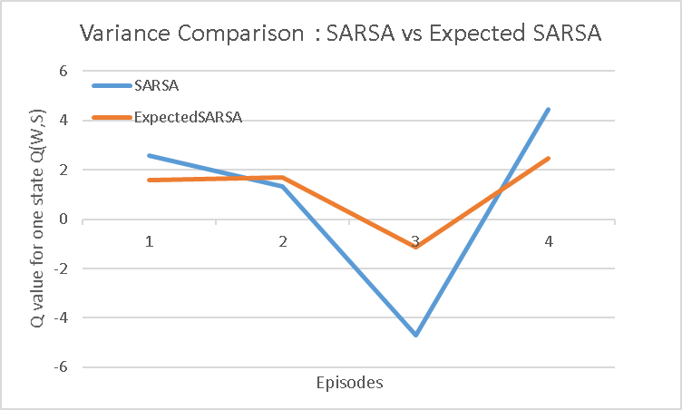
Expected SARSA
Ꜫ = 0.1
γ = 0.9
α = 0.8
Q₁
Q₂
Q₃
Q₄
1.6 0 0 1.37 0 0
2.59 0 -8 1.57 0
2.59 0 6.4 -1.14 0
2.59 0 6.4 +2.46 0
Episode 1: C, F, 2, W, S, 1, C , F
Episode 2: C, F, 2, C, F, 2, W, S, 1, W , S, 1, W , F, -10, O
Episode 3: W, S, +1, W, F, +10, O
t=0 : Q(W,S) = 1.57 + 0.8 [1+ (0.9*((-8*0.5) + (1.57*0.5)))-1.57] = -1.14
t=1 : Q(W,F) = -8 + 0.8 [10+ (0.9*0)+8] = ~+6.4
Episode 4: W, S, +1, W, F
t=0 : Q(W,S) = -1.14 + 0.8 [1+ (0.9*((-1.14*0.5)+(6.4*0.5)))+1.14] = ~+2.46
Continued for one more episode….
Assumed likelihood for all the states “_” for simplicity :P(S|_) = 0.05, P(F|_) = 0.5
Deep Reinforcement Learning
Notes:
-2.484

Slide 86
Temporal Difference Learning Methods
Off Policy Control Algorithms
Q-Learning

Slide 87
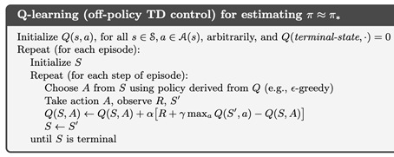
Q-Learning
Ꜫ = 0.1
γ = 0.9
α = 0.8
Q₀
Q₁
Q₂
0 0 0 0 0 0
Episode 1: C
π
Target Policy : Greedy (MAX) is used to evaluate /update the Q values
Behavior Policy : ε-greedy is used to select actions based on the policy derived from Q - Value
Deep Reinforcement Learning

Slide 88
Q-Learning
Ꜫ = 0.1
γ = 0.9
α = 0.8
Q₁
Q₂
Q₃
1.6 0 0 0 0 0
Episode 1: C, F, 2, W, S
Q(C,F) = 0 + 0.8 [2+ (0.9* MAX{Q(W,S),Q(W,F)} )-0] = 1.6
π
Behavior Policy : ε-greedy is used to select actions based on the policy derived from Q - Value . Here action “F” for state “C”
Target Policy : Greedy (MAX) is used to evaluate /update the Q values.
Deep Reinforcement Learning

Slide 89
Q-Learning
Ꜫ = 0.1
γ = 0.9
α = 0.8
Q₁
Q₂
Q₃
1.6 0 0 17.15 0 0
Episode 1: C, F, 2, W, S, 20, C , F
Q(W,S) = 0 + 0.8 [20+ (0.9*(MAX{Q(C,S), Q(C,F)})-0] = ~17.15
π
Terminating episode 1 after 2 steps. In practice, we can define an episode cutoff (e.g., after 2 or10 steps or when Overheated occurs). If Overheated isn’t reached, still the episode an be programmed to end artificially. That’s how learning continues.
Deep Reinforcement Learning

Slide 90
Q-Learning
Ꜫ = 0.1
γ = 0.9
α = 0.8
Q₁
Q₂
Q₃
1.6 0 0 17.15 0 0
16.16 0 -8 11.64 0 0
Episode 1: C, F, 2, W, S, 20, C , F
Episode 2: C, F, 2, C, F, 4, W, S, -5, W , S, 1, W , F, -10, O
t=0 : Q(C,F) = 1.6+0.8(2+0.9(MAX{1.6,0})−1.6)=~3.07
t=1 : Q(C,F) = 3.07+0.8(4+0.9(MAX{0,17.15})−3.07)=~16.16
t=2 : Q(W,S) = 17.15+0.8(-5+0.9(MAX{0,17.15})−17.15)=~11.78
t=3 : Q(W,S) = 11.78 + 0.8 [1+0.9(MAX{0,11.78})−11.78] = ~11.64
t=4 : Q(W,F) = 0 + 0.8 [-10+ (0.9*0)-0] = ~-8
π
Target Policy : Greedy (MAX) is used to evaluate /update the Q values
Behavior Policy : ε-greedy is used to select actions based on the policy derived from Q - Value
Deep Reinforcement Learning

Slide 91
Q-Learning
Ꜫ = 0.1
γ = 0.9
α = 0.8
Q₁
Q₂
Q₃
Q₄
Q₅
Q₆
1.6 0 0 17.15 0 0
16.16 0 -8 11.64 0 0
Observe the difference in value updates w.r.t Q(W,S) between successive time steps in episodes 3 to 6.
The true value is approx. Q(W,S) = 15
Due to MAX bias the values are overestimated and this is more pronounced in the presence of NOISE
Sometimes this diverges from true value.
Solution to tackle : Double Q-Learning
** But in near-deterministic , less noisy environment , Q-learning helps in faster convergence!
16.16 0 6.4 14.71 0 0
16.16 11.39 6.4 22.50 0 0
π
16.16 11.39 6.4 16.70 0 0
16.16 11.39 6.4 19.37 0 0
Episode 1: C, F, 2, W, S, 20, C
Episode 2: C, F, 2, C, F, 4, W, S, -5, W , S, 1, W , F, -10, O
Episode 3: W, S, +5, W, F, +10, O
Episode 4: C, S, +1, W, S, +10, C
Episode 5: W, S, -5, W
Episode 6: W, S, +5, W
Few more episodes are completed and the results of the update per Q(State, Action) is shown . Students are advised to practice this.
Deep Reinforcement Learning

Slide 92
Temporal Difference Learning Methods
Off Policy Control Algorithms
Double Q-Learning

Slide 93
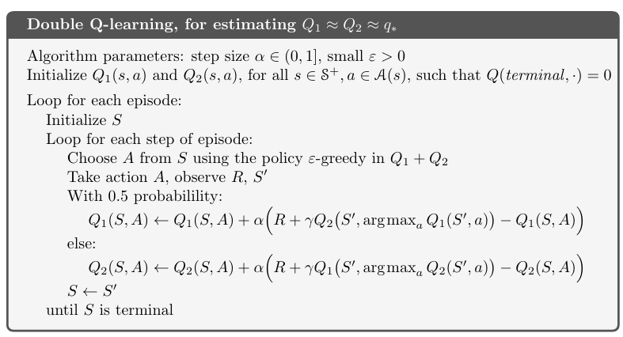
Target Behavior
Ꜫ = 0.1
γ = 0.9
α = 0.8
Q₀
Q₁
Q₂
0 0 0 0
5 1 5 15
Episode 1: C
π
Target Policy : Q2 - Table
Behavior Policy : Q1-Table is available from other sources/experience/logged data. Above algorithm learns to update this as well.
Deep Reinforcement Learning

Slide 94
Target Behavior
Ꜫ = 0.1
γ = 0.9
α = 0.8
Q₁
Q₂
Q₃
5.2 0 0 0
5 1 5 15
Episode 1: C, F, 2, W, S
Q2(C,F)
= 0 + 0.8 [2+ (0.9* Q1(W, ARGMAX{Q2(W,S),Q2(W,F)}) )-0]
= 0 + 0.8 [2+ (0.9* Q1(W, F)-0] #Here both S & F had same values hence randomly “F” is chosen
= 0 + 0.8 [2+ (0.9* 5) - 0]
= 5.2
π
Target Policy : Q2 - Table
Behavior Policy : Q1-Table is available from other sources/experience/logged data. Above algorithm learns to update this as well.
Deep Reinforcement Learning

Slide 95
Target Behavior
Ꜫ = 0.1
γ = 0.9
α = 0.8
Q₁
Q₂
Q₃
5.2 0 0 19.6
5 1 5 15
Episode 1: C, F, 2, W, S, 20, C , F
Q2(W,S) = 0 + 0.8 [20+ (0.9*(Q1(C, ARGMAX{Q2(C,S), Q2(C,F)}) )-0]
= 0 + 0.8 [20+ (0.9*(Q1(C, F) )-0]
= 0 + 0.8 [20+ (0.9*5)-0]
= ~19.6
π
Terminating episode 1 after 2 steps. In practice, we can define an episode cutoff (e.g., after 2 or10 steps or when Overheated occurs). If Overheated isn’t reached, still the episode an be programmed to end artificially. That’s how learning continues.
Deep Reinforcement Learning

Slide 96
Target Behavior
Ꜫ = 0.1
γ = 0.9
α = 0.8
Q₁
Q₂
Q₃
5.2 0 0 19.6
5 1 5 15
6.24 0 -8 13.74
18.3 1 5 15
Episode 1: C, F, 2, W, S, 20, C , F
Episode 2: C, F, 2, C, F, 4, W, S, -5, W , S, 1, W , F, -10, O
t=0 : Q2(C,F) = 5.2+0.8(2+0.9(Q1(C, ARGMAX{Q2(C,F), Q2(C,S)})) −5.2)=~6.24
For step 2 : The loop goes to Q1(S,A) where the behavior policy is updated:
t=1 : Q1(C,F) = 5+0.8(4+0.9(Q2(W, ARGMAX{ Q1(W,S) , Q1(W,F) }) )−5)
= 5+0.8(4+0.9(Q2(W, ARGMAX{ 15, 5}) )−5)
= 5+0.8(4+0.9(Q2(W, S) )−5)
= 5+0.8(4+0.9(19.6 )−5) =~18.3
Only two time step is shown here .
Other time steps updated target policy ie., Q2 table and the
result is tabulated above.
π
Target Policy : Q2 - Table
Behavior Policy : Q1-Table is available from other sources/experience/logged data. Above algorithm learns to update this as well.
Deep Reinforcement Learning

Slide 97
Target Behavior
Ꜫ = 0.1
γ = 0.9
α = 0.8
Q₁
Q₂
Q₃
Q₄
Q₅
Q₆
5.2 0 0 19.6
5 1 5 15
6.24 0 -8 13.74
18.3 1 5 15
Note : Only in Episode 3 step 1 , episode 4 step 2, the loop is simulated to Q1(S,A) loop, where the behavior policy is updated:
6.24 0 9 13.74
18.3 1 5 16.89
6.24 12.9 9 15.71
18.3 1 5 15.87
π
6.24 12.9 9 10.57
18.3 1 5 15.87
6.24 12.9 9 13.7
18.3 1 5 15.87
Episode 1: C, F, 2, W, S, 20, C
Episode 2: C, F, 2, C, F, 4, W, S, -5, W , S, 1, W , F, -10, O
Episode 3: W, S, +5, W, F, +10, O
Episode 4: C, S, +1, W, S, +10, C
Episode 5: W, S, -5, W
Episode 6: W, S, +5, W
Two more episodes are completed and the results of the update per Q(State, Action) is shown . Students are advised to practice this.
Deep Reinforcement Learning

Slide 98
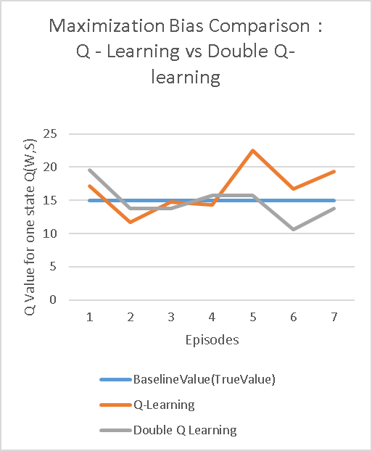
Target Behavior
Ꜫ = 0.1
γ = 0.9
α = 0.8
Q₁
Q₂
Q₃
Q₄
Q₅
Q₆
5.2 0 0 19.6
5 1 5 15
6.24 0 -8 13.74
18.3 1 5 15
6.24 0 9 13.74
18.3 1 5 16.89
6.24 12.9 9 15.71
18.3 1 5 15.87
6.24 12.9 9 10.57
18.3 1 5 15.87
6.24 12.9 9 13.7
18.3 1 5 15.87
Deep Reinforcement Learning

Slide 99

DP TD MC
s
a
s`
a`
.
.
S_{T}
Deep Reinforcement Learning

Slide 100

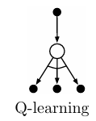
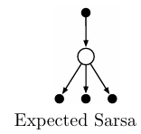
DP TD MC
s,a
s`
a`
.
.
S_{T}
Deep Reinforcement Learning

